Slide 1
An introduction to Aegon
360 Scorecard June / Q2 2016
FIB
Futuready Insurance Broker
Sendy
Jakarta, 27 June, 2017
CEO, Futuready Insurance Broker

Slide 2
Opportunity
Futuready Insurance Broker
60%
Of New Life premiums are Unit Linked
230 Million
Indonesian Do Not Own Individual Policy¹
26
Average Branch Office per Insurance Companies²
Exclude state mandatory policy. OJK Insurance Statistic 2015 state that there are 13 million individual policies at Life Insurance companies.
3,573 branch divided by 139 insurance companies
Notes:
Indonesian Insurance Market is Underpenetrated with Limited Product Variety & Geographic Reach

Slide 3
Root Cause
Futuready Insurance Broker
Distribution
Customer Feel Force to Buy Certain Type of Product
Agents Sells Easiest Product to Sell
Customer Don’t See Product Relevant For Their Need
Agents Finds it Difficult to Effectively Sell too Many Varieties
Customer Don’t See an Insurance serving their area
Unprofitable to Serve Low Demand area with Face to Face Channels
Customer Don’t Feel they have selection
Captive Channels Cannot Be Expected to Host Competitors
Customer Complains of Misrepresentation or Misinformed
Agents Feel Justified Since They Are Taking Full Sales Risk
Customer Equalize Buying Insurance with Poor Experience
Push Method Distribution Model Relying on Personal Relationship
Customer Questions Claim Reliability Despite Data
Difficult to Ensure Agents Post-Sales Service Level
No Pricing Differentiation Between Novice & Expert Customer
Commission is Priced based on Conversion of Resistors
More Customer Issues…….
More Distribution Related Problems…..
Notes:
Captive & High Cost Distribution Channels is Incentivized to Sell The Few Products That Makes The Most Margin

Slide 4
Why Distribution
Futuready Insurance Broker
A Good Part of Premium
Hidden Cost Impact
Less Leverage from Other Areas
Commissions has more impact on price for customers and profit for investor than any other factor
Defining the Optimum Arbitrage of Premium-Cost-Claims is Difficult
Other Areas Can Always Be Improved, but Less Pronounced Impact
Notes:
Distribution is at the heart of the problem and opportunity when it comes to providing financial inclusivity in Indonesia
Direct Commission could explain up to 50% of Premium
For individual lines, loss ratio unlikely to change drastically
Often already limited space in operational cost improvement
Investor target IRR is market dictated, primarily global risk free rate adjusted with country risk
Commissions has more impact on price for customers and profit for investor than any other factor
Sales force needs a management team, often salaried with sufficient bonus to incentivize them
The sales force and their management team needs to be supported by functional team
The sales force and their management team need to be supervised and audited
High incentive leads to bad quality accounts with higher claim ratio and/or exposure
Defining the Optimum Arbitrage of Premium-Cost-Claims is Difficult
Actuary: Actuary Writes What the Market Demands. Actuarial Tables Doesn’t Change Frequently
Underwriting: Granular Customer Data Can Lead to More Granular Pricing, But of Limited Value If Cannot Be Monetized
Operations: Insurer have Decades of Ongoing Work with IT and Consultancy Helping Digitize Operations
Other Areas Can Always Be Improved, but Less Pronounced Impact

Slide 5
Stuck
Futuready Insurance Broker
Insurer Willingness to Pay Top Dollar for Agency Office & Bancassurance Increases
Agency Office & Bancassurance Do Bring Business
New Entrants See No Compelling Channel Beyond Agents & Bancassurance
Insurer Pay Top Dollar for Agency Office & Bancassurance
Conundrum
Only 10% of Indonesian Buys Insurance Policy
Insurer Have No Clear Direction on How to Grow Beyond Existing Channel
Something is Deeply Wrong with Insurance Distribution
Notes:
New Entrants See No Compelling Channel Beyond Agents & Bancassurance
Insurer Pay Top Dollar for Agency Office & Bancassurance
Agency Office & Bancassurance Do Bring Business
Insurer Willingness to Pay Top Dollar for Agency Office & Bancassurance Increases
Conundrum
Only 10% of Indonesian Buys Insurance Policy
Insurer Have No Clear Direction on How to Grow Beyond Existing Channel
Something is Deeply Wrong with Insurance Distribution

Slide 6
Principles in Defining a Solution
Futuready Insurance Broker
For Profit
Works Within Current Legal Framework
Charity Doesn’t Scale
Illegal Innovation in Financial Service Destroy Customer’s Money. It’s not a ride, it’s an insurance premium
Address Customers Need Gap
Enable Differentiation
Issues of selection, objectivity, transparency, convenience, post-sales service
Target customers who knows & want insurance and deliver through product selection and experience
Innovative Cost Structure
Compelling Economic Case For Insurer
Enables More Variety of Product Categories & Price Points to Be Available at More Geographies
Help insurer reduce upfront investment or per unit cost and provide better value products for customers

Slide 7
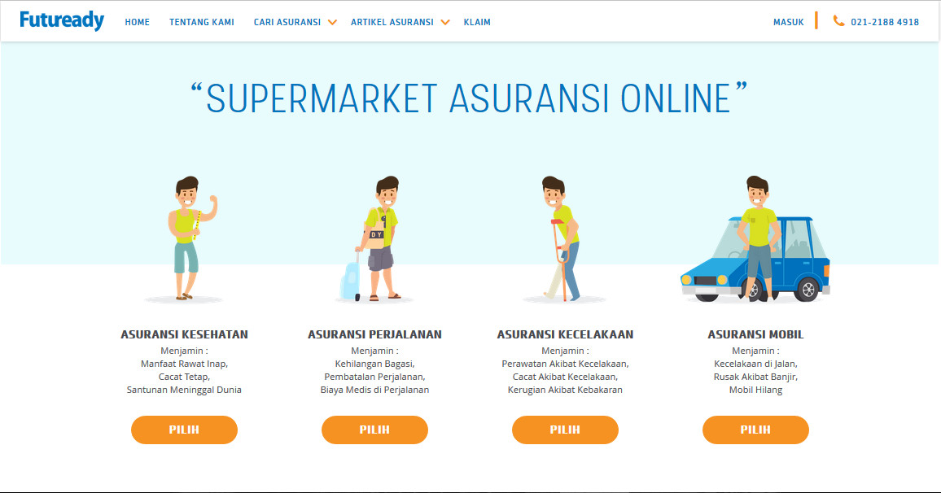
Solution
Futuready Insurance Broker
Futuready Insurance Broker
Credible: licensed insurance broker
Selection: across and within categories
Objective: No advertising fee from insurer
Control: customers decides when to advance the purchase process
Transparency: all information on insurance product available onsite
Convenient: all process from discovery, decision, payment and policy online. Not just lead collection.
Post sales: broker have authority and obligation to provide post-sales support, including claim
Portfolio: broker help customers find the best insurer for various insurance needs
OJK License:
No. KEP-518/NB.1/2015
APPARINDO Member:
No. 219-2015/APPARINDO/2015

Slide 8
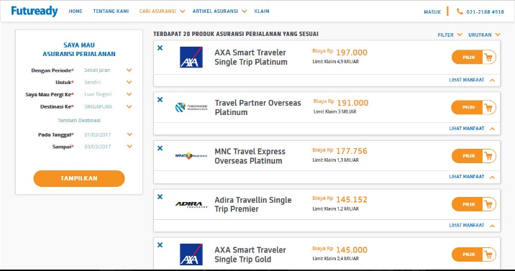
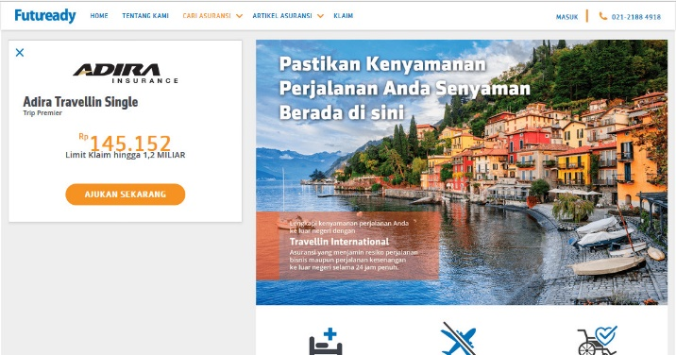
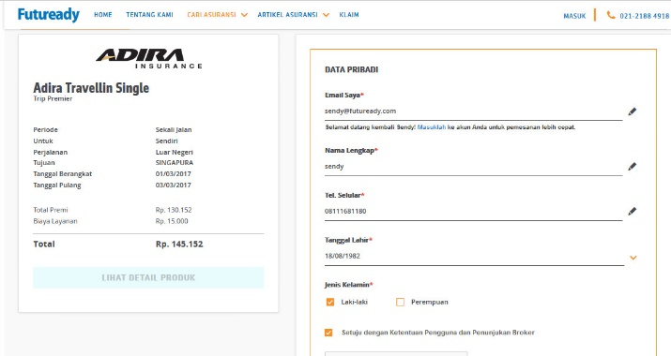
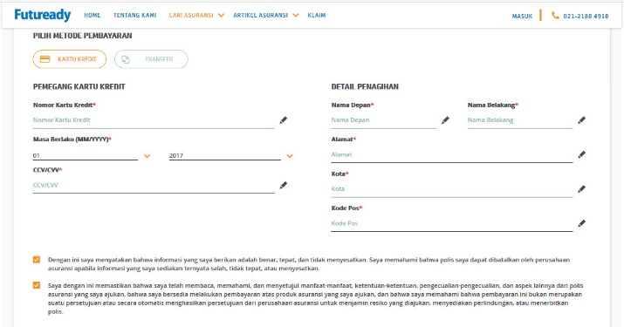
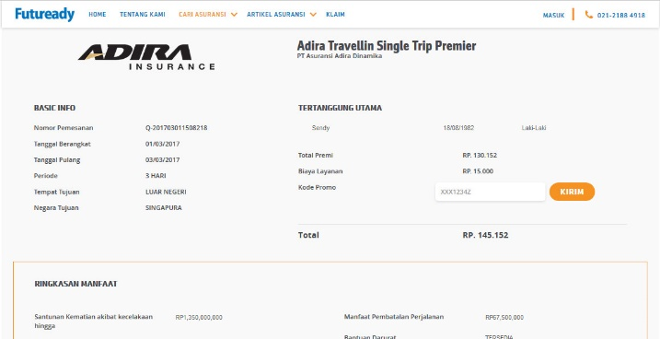
Typical Customer Journey
Futuready Insurance Broker
1
View product options
2
View product details
3
Confirm interest
6
Policy Delivery
5
Complete Payment
4
Review Payment
E-policy via E-mail
Policy Summary via Hadcopy

Slide 9
Not Compete with Incumbent Channels
Futuready Insurance Broker
Futuready
Traditional Brokers
Target Retail Customers with Simple Insurance Needs
Target Premium is Rp 500,000 to Rp 5 million, per purchase or on a per annual basis
Build own customer base with pull marketing models
Target Corporations with Complex Insurance Needs
Insurance Agents
Bancassurance
Target Premium is at least Rp 6 million, per purchase or on a per annual basis
Leverage banks customer base

Slide 10
Our Strength
Futuready Insurance Broker
License
Technology
Selection
Insurer have License & Technology, but very few insurer would allow customer to select other insurer product in their own website
And even if it’s willing, customers could question the genuineness of such offer
Some companies that leverage technology has offered selection to customers without a license. Either disregarding the requirement or claiming, falsely, that it doesn’t apply to them
The absence of license makes their business perpetually under threat from a firm application of the existing law & regulation
Many traditional brokers have selection and license but are not interested to develop the technology to address the retail segment

Slide 11
Not Just a Website
Futuready Insurance Broker
Inbound Contact Centre
Partner E-Commerce Companies
www.Futuready.com
Futuready Insurance Broker
B2B2C Partners
Individual Referrers
SME Affiliates

Slide 12
Progress
Futuready Insurance Broker
History
Market Response
Started as a content site in Aug 2013, model was stopped mid 2015
Obtained insurance broker license on June 2015
New team hired in Dec 2015
E-Sales launched in May 2016
E-Commerce Partnership launched in May 2017
Policy Sales Growth, indexed to 100

