Slide 1
The Customer Experience & Intelligence Company

Slide 2
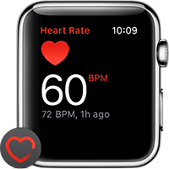
Radical Shift in Consumer Behavior & Technology
Data Deluge
Mobility
Sharing Economy
Insta –fication
Aware

Slide 3
AUREUS: Delivering Actionable Insights at the Point of Decision
EPIC
Customer Experiences
Predictive Analytics
+
Machine Learning
@
=

Slide 4
@ Aureus
USP
Alumni
Pedigree
Recognized By
Only Analytics Platform designed for Insurance and Banking
Funded & Backed by Industry Veterans and Technology Gurus from Google, Credit Suisse, etc.
CUSTOMER RECORDS PROCESSED
DATA VOLUME PROCESSED
1
4
M
N
+
3
T
B
+

Slide 5
We work with some of the best
(SBI Life)
(Aegon Life)
(TATA AIA)
(DHFL Pramerica)
(Bharti AXA)

Slide 6
The Product Suite
Re-imagining Customer Experience
Retention | Cross Sell | Claims | Fraud
NPS | Customer Loyalty

Slide 7
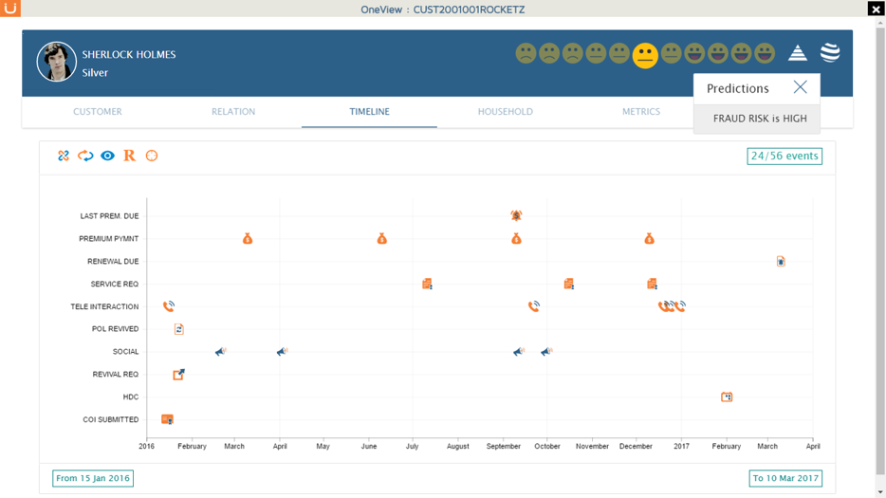
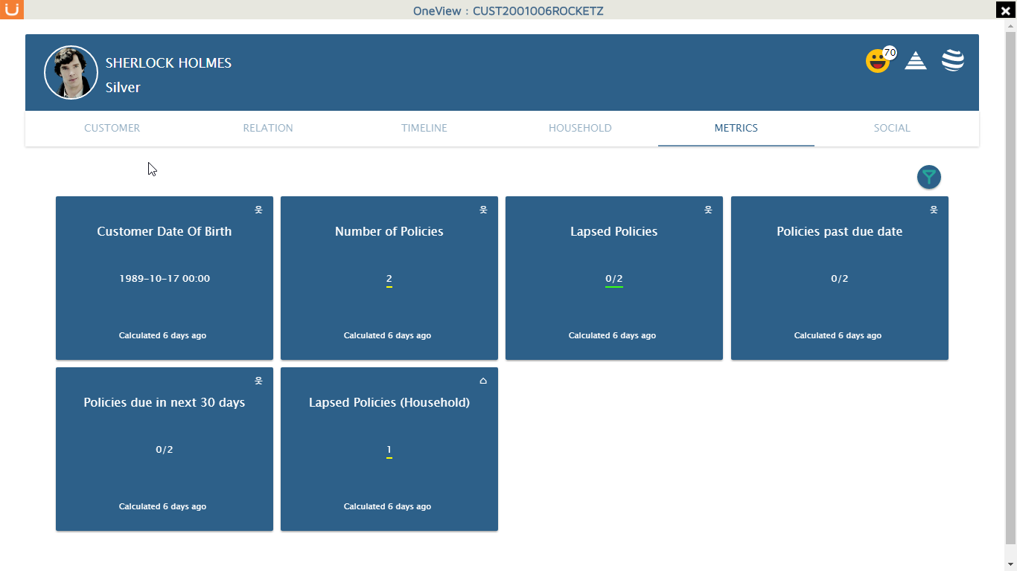
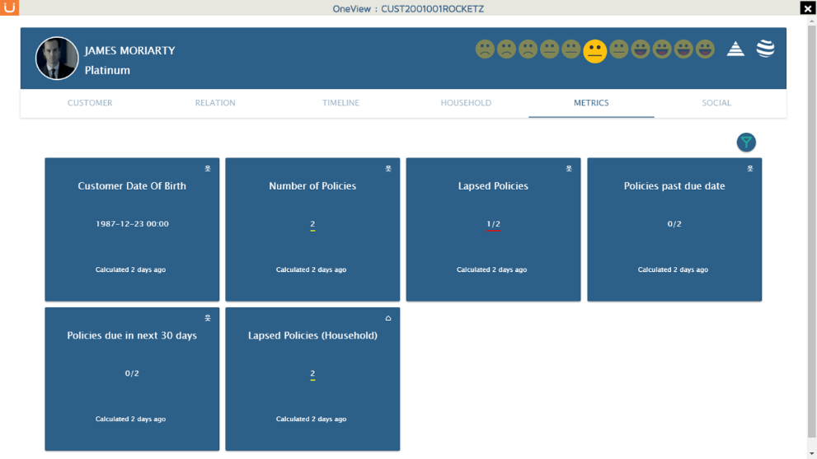
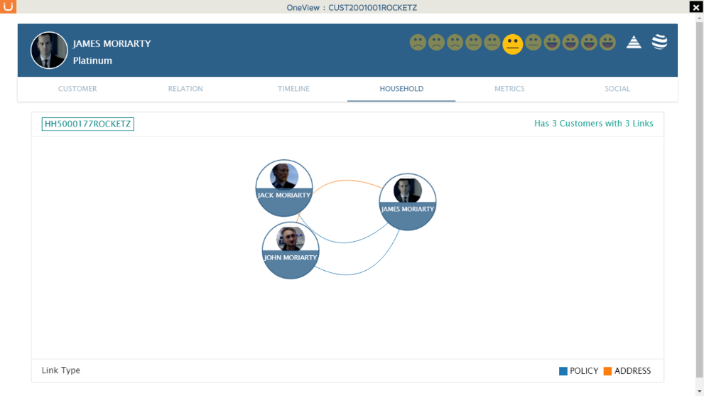
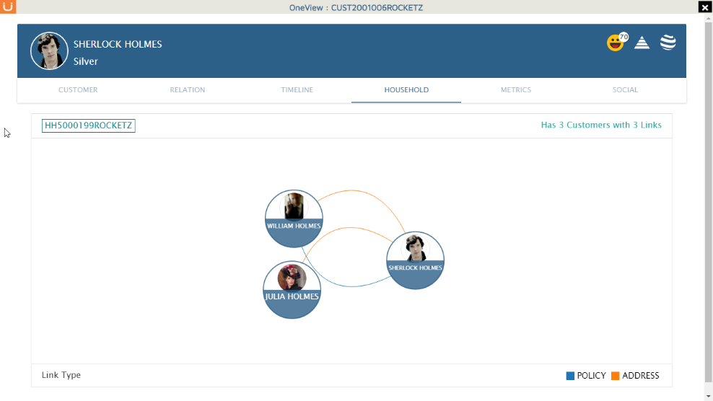
Business Ready Analytics Platform
INTERACTIONS
+
TRANSACTION
ONE VIEW
CORELATIONS
HOUSEHOLDING
INDUSTRY
KPIs
RETENTION
ANALYTICS
CROSS SELL
ANALYTICS
CLAIMS ANALYTICS
FRAUD ANALYTICS

Slide 8
“
Aureus’ Claim fraud prediction allows our investigators to focus only on ~10% of early claims for investigation and is able to capture ~80% of all fraud cases.
COO,
Large National Insurer

Slide 9
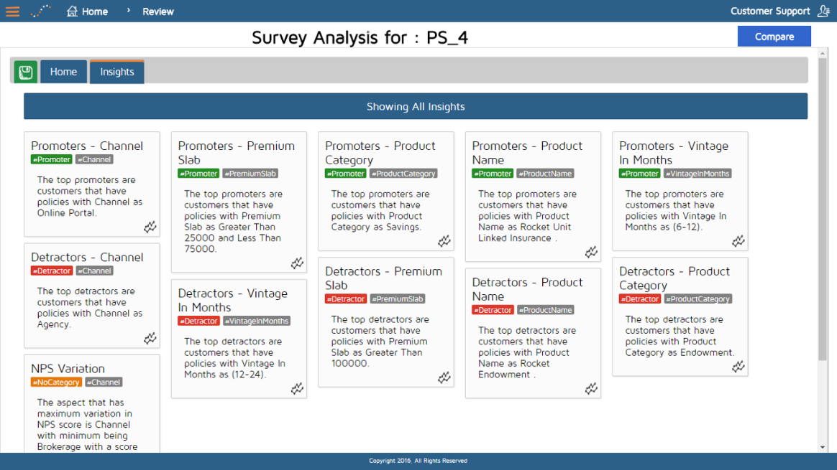
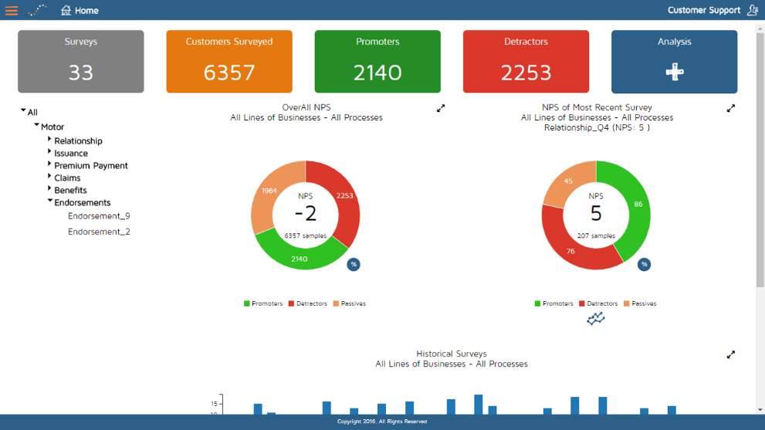
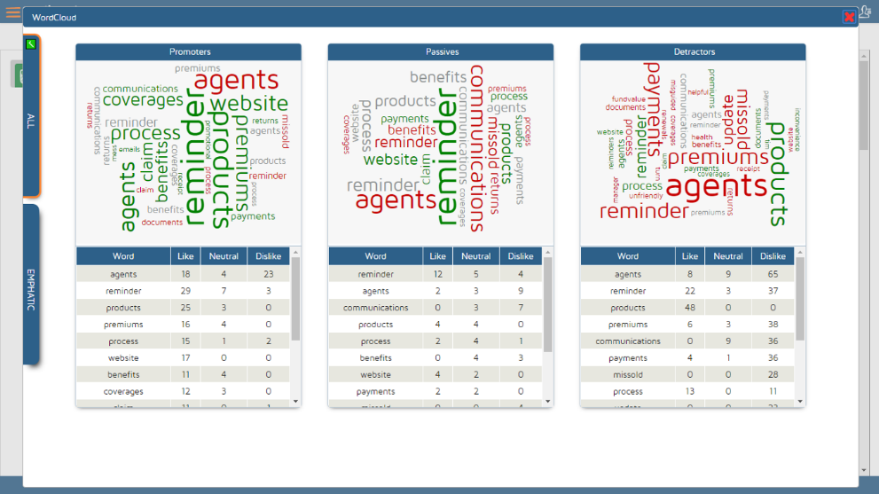
Actionable Net Promoter Score Analytics
CUSTOMER JOURNEY ANALYSIS
ADVANCED TEXT ANALYTICS
SURVEY + INTERACTION DATA
NATURAL LANGUAGE PROCESSING
ACTIONABLE INSIGHTS IN ENGLISH
MACHINE LEARNING

Slide 10
“
PULSE helped us improve our Net Promoter Score by 40 points thus leading to improved overall Customer Experience.
Manish Madan,
Head Customer Service

Slide 11
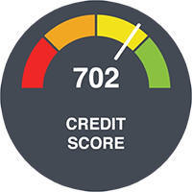
Built for Business
Enterprise Data
Social Data
External Data
Business User Ready
Industry Specific
Easy Subscription Plans
Cloud Hosted
Scalable
Integrateable

Slide 12
Make Customer Experience your Differentiator.
www.aureusanalytics.com
blog.aureusanalytics.com
https://www.linkedin.com/company/aureus-analytics
@AureusAnalytics
info@aureusanalytics.com

